Slide 1

Project Title -Netflix Dataset Analysis
Hrishikesh Hushe
AICTE_VOIS OL 2001-4K-171

Slide 2

PROBLEM STATEMENT
Netflix has become one of the most prominent global streaming platforms, continuously expanding its library with a mix of original productions and licensed content. However, with growing competition from platforms like Amazon Prime, Disney+, and regional OTT providers, Netflix must strategically analyze its content catalog to identify strengths, gaps, and opportunities.
The specific problem to be addressed in this project is:
“Content Trends Analysis for Strategic Recommendations.”
The aim is to uncover how Netflix’s content distribution (Movies vs. TV Shows, genres, and country contributions) has evolved over the years. This will enable the identification of key genres, audience preferences, and strategic insights into global content expansion.

Slide 3
Project Description This project analyzes the Netflix dataset (7,789 records, 11 columns) that contains details of movies and TV shows available on the platform from 2008 to 2021. The dataset includes attributes like title, director, cast, country, release date, rating, duration, type, and genres. The main goal is to perform a content trends analysis to understand how Netflix’s catalog has evolved over the years in terms of: Balance between Movies and TV Shows Genre distribution and changing popularity Country contributions and global representation By identifying these patterns, the project will provide strategic insights and recommendations for Netflix to strengthen its content acquisition and production strategy in a highly competitive OTT market.

Slide 4

WHO ARE THE END USERS?
Netflix Content Strategy & Management Teams – to decide which genres, formats, or countries to invest in.
Data Analysts / Business Analysts – to use insights for reporting and decision-making.
Marketing Teams – to align promotions with trending genres and regions.
OTT Industry Researchers – to study streaming trends and competition.

Slide 5

Technology Used
Python – Programming language for analysis
Pandas & NumPy – Data cleaning and manipulation
Matplotlib & Seaborn – Data visualization and charts
Jupyter Notebook / Google Colab – For coding and experimentation
PowerPoint (pptx) – For presenting results
GitHub – For version control and project hosting

Slide 6
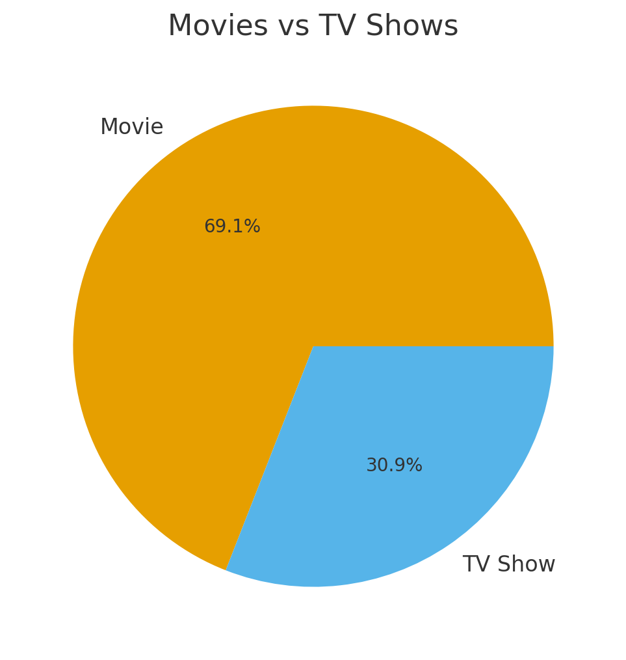
RESULTS1
[Add screen shots of your code or Chart(s) ]

Slide 7
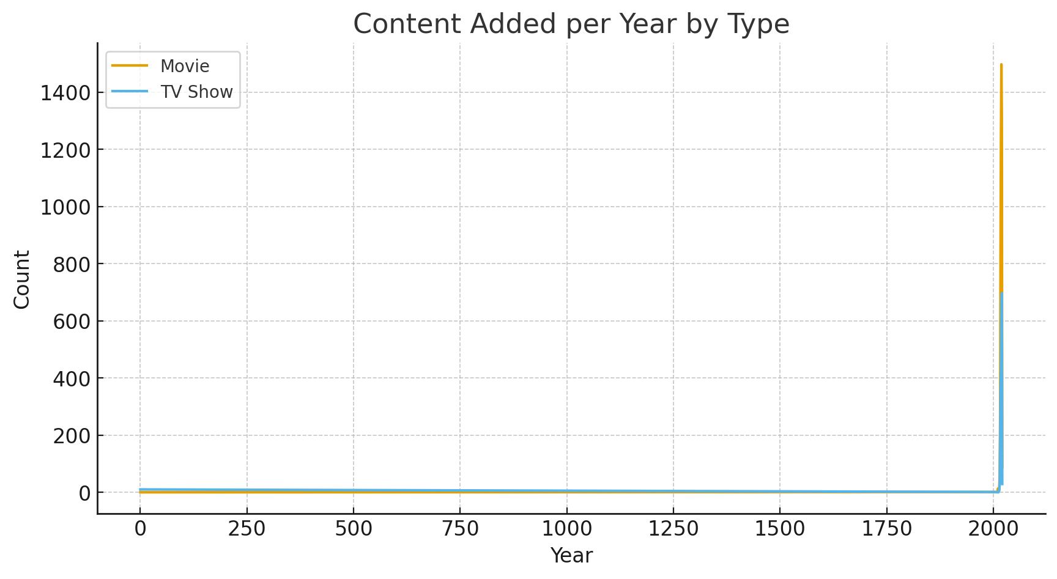
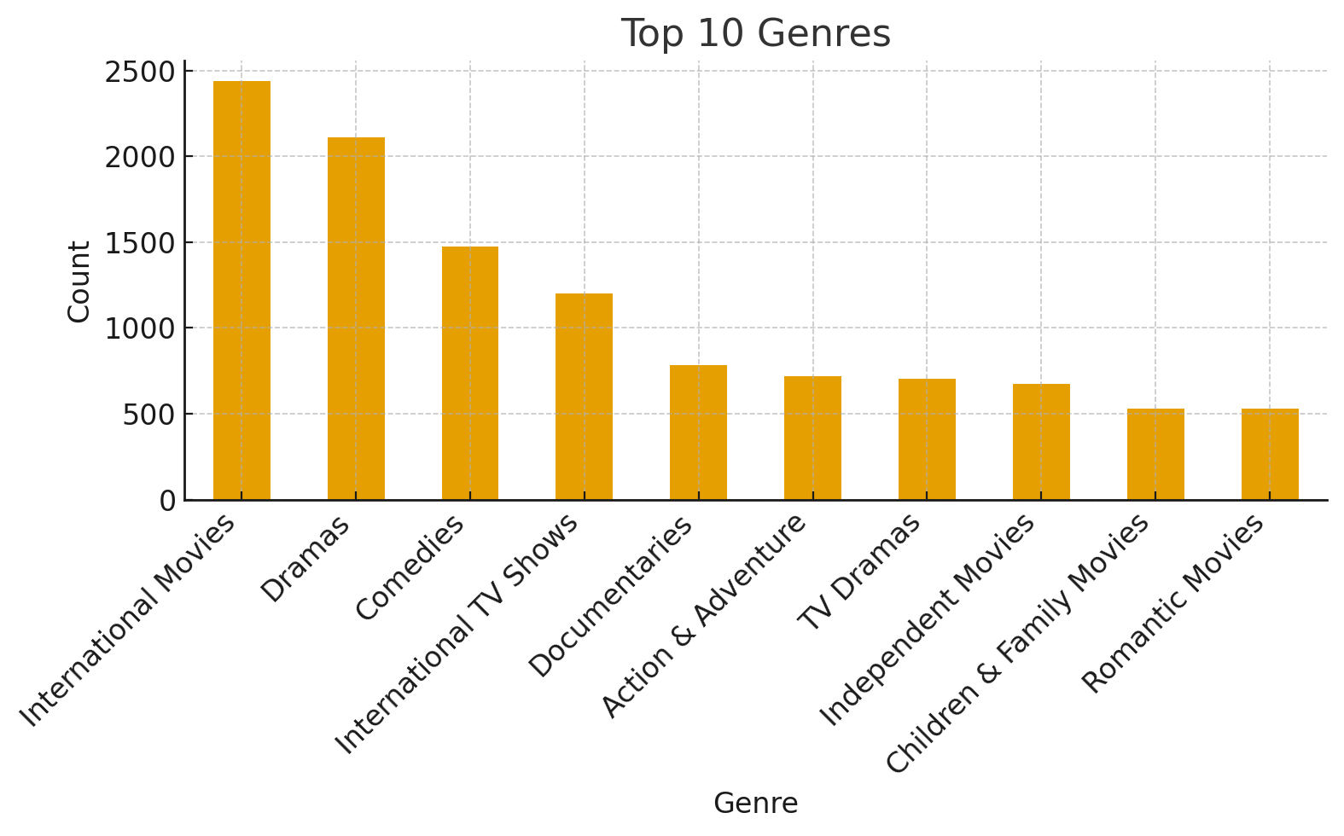
RESULTS2
[Add screen shots of your code or Chart(s) ]

Slide 8
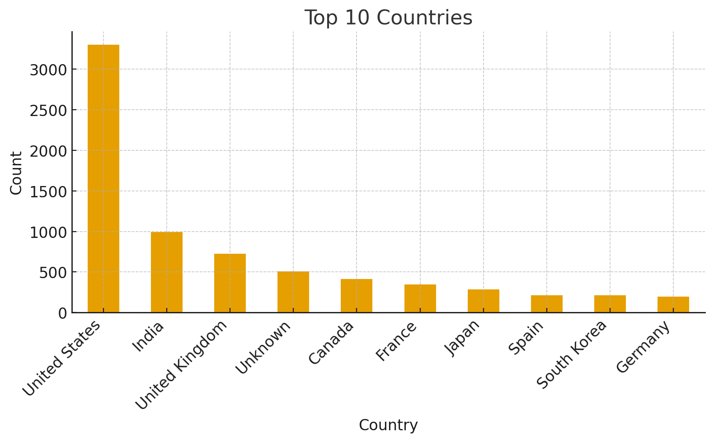
RESULTS3
[Add screen shots of your code or Chart(s) ]

Slide 9
GitHub repository
https://github.com/Hrishikesh-Hushe/VOIS_AICTE_Oct2025_MajorProject_HrishikeshHushe
VOIS_AICTE_Oct2025_MajorProject_HrishikeshHushe

Slide 10

Getting started with Basics of Python Certificate
[Paste your Certificate Here]

Slide 11
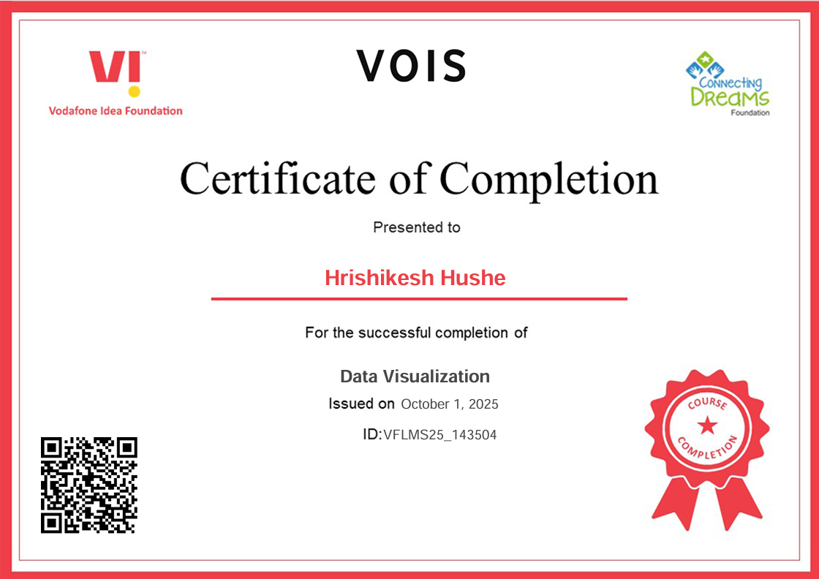
Data Visualization Certificate
[Paste your Certificate Here]

Slide 12
Thank you
.
.

